Slide 1


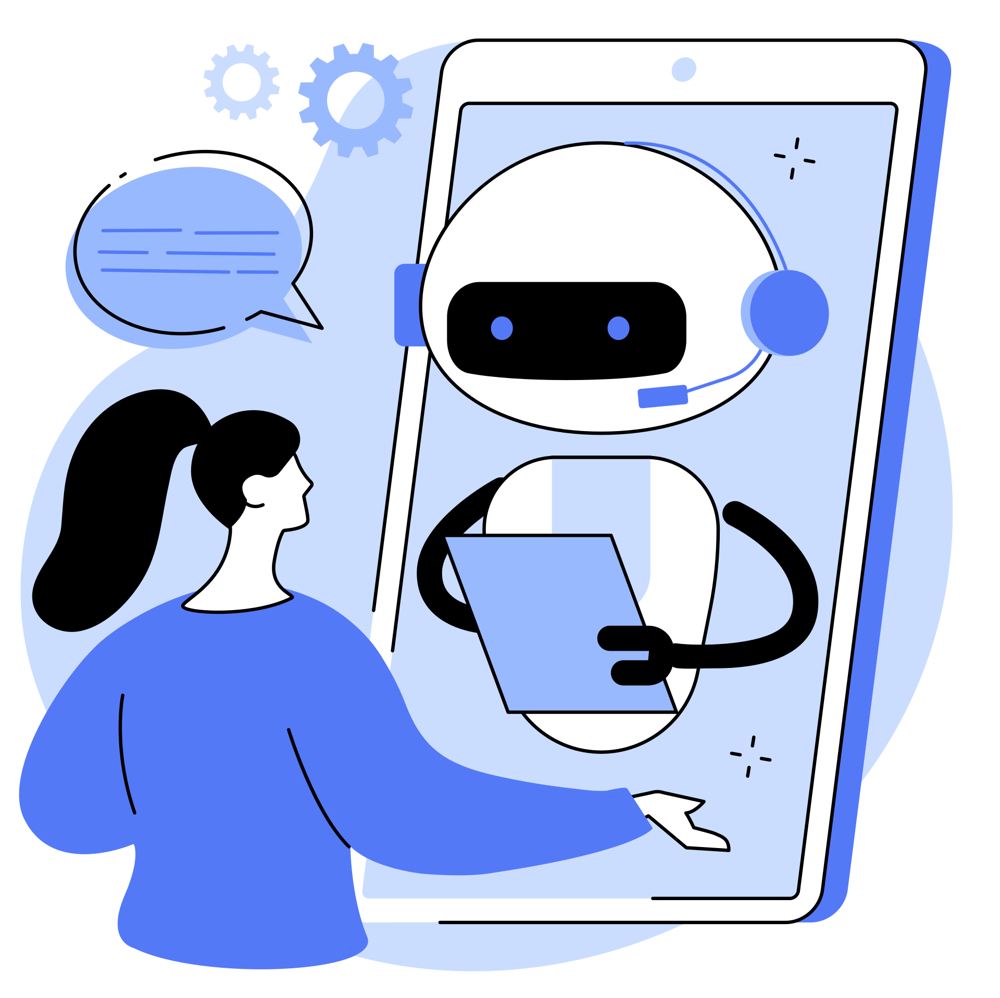
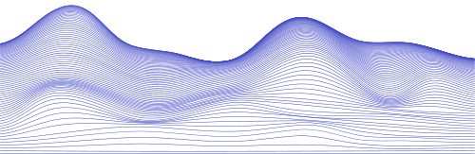

WELCOME TO
HEALTHCARE
CHATBOT

Slide 2


TABLE OF CONTENT
01
INTRODUCTION
02
BACKGROUND AND CONTEXT
03
CODE AND DATASET
04
FINDINGS AND ANALYSIS
05
CONCLUSION AND NEXT STEPS

Slide 3


INTRODUCTION
our innovative chatbot leverages natural language processing to provide instant and personalized healthcare support. The chatbot offers users a user-friendly interface for medical inquiries, appointment scheduling, and health-related information retrieval to elevate the overall healthcare experience.

Slide 4
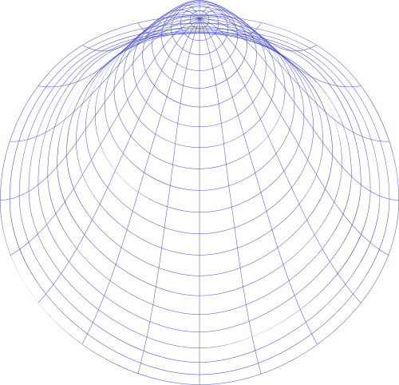
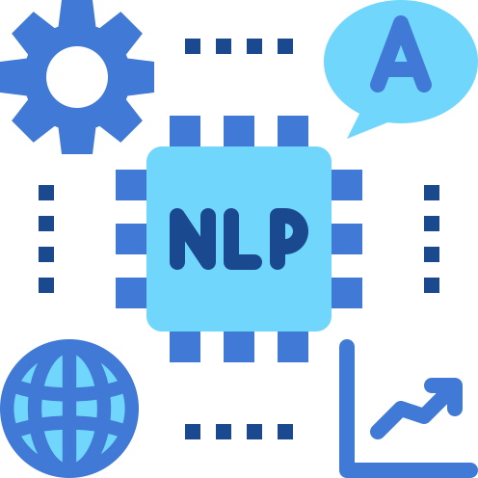

BACKGROUND AND CONTEXT
The healthcare industry faces escalating patient volumes and communication challenges to enhance accessibility and improve overall patient care. In the digital transformation era, healthcare is witnessing a paradigm shift with technology reshaping patient engagement and communication. Our project introduces a Healthcare Chatbot at the forefront aligning with this transformative wave for enhanced healthcare services.
In our exploration of healthcare chatbot research, Paper 1 focuses on building a chatbot using NLP, addressing 24/7 access, and appointment scheduling. Paper 2 introduces a personal healthcare chatbot leveraging AI and machine learning for customized diagnoses, Paper 3 tackles challenges in healthcare accessibility through an AI-based chatbot aiming to analyze illnesses and reduce costs, and Paper 4 contributes to healthcare AI with a specialized dataset and a prototype chatbot for medical diagnosis. Finally, Paper 5 introduces a medical chatbot utilizing NLP and achieving a 94% accuracy in disease prediction through SVM.

Slide 5

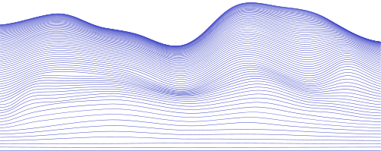

CODE LINK
https://colab.research.google.com/drive/1nxA5L2g863A27Z_3uHaI_NplNDoFkJ5m?usp=sharing
CODE AND
DATASET
DATASET EXPLORATION
The dataset employed in this project is sourced from a CSV file named 'medquad.csv.' It encompasses relevant information crucial for the development and training of healthcare and consists of 3 features [answers, questions, disease]
DATASET USAGE
The code integrates a question-answering pipeline from the transformers library(pipeline). It utilizes the BERT model, fine-tuned for question-answering tasks, to extract answers from the 'answer' column given a specific 'question.' and vice versa.

Slide 6


Code implementation
  This ensures uniformity in the textual data, allowing for more effective NLP analysis by converting all text entries to lowercase and removing numerical values
TRIGRAMS, ARE GENERATED FROM THE 'ANSWER' COLUMN OF THE DATASET. THIS TECHNIQUE PROVIDES INSIGHTS INTO THE CO-OCCURRENCE OF WORDS
  refine the textual data, making it suitable for subsequent analysis
FINDINGS AND
ANALYSIS
Preliminary findings indicate the chatbot's success in symptom-based disease detection offering a promising alternative to traditional diagnostic processes as Users appreciate the discreet nature of the interaction, particularly beneficial for those with social anxiety. The Final findings is a chatbot model using NLP techniques to understand the patient's question or answer the way he entered the info.

Slide 7
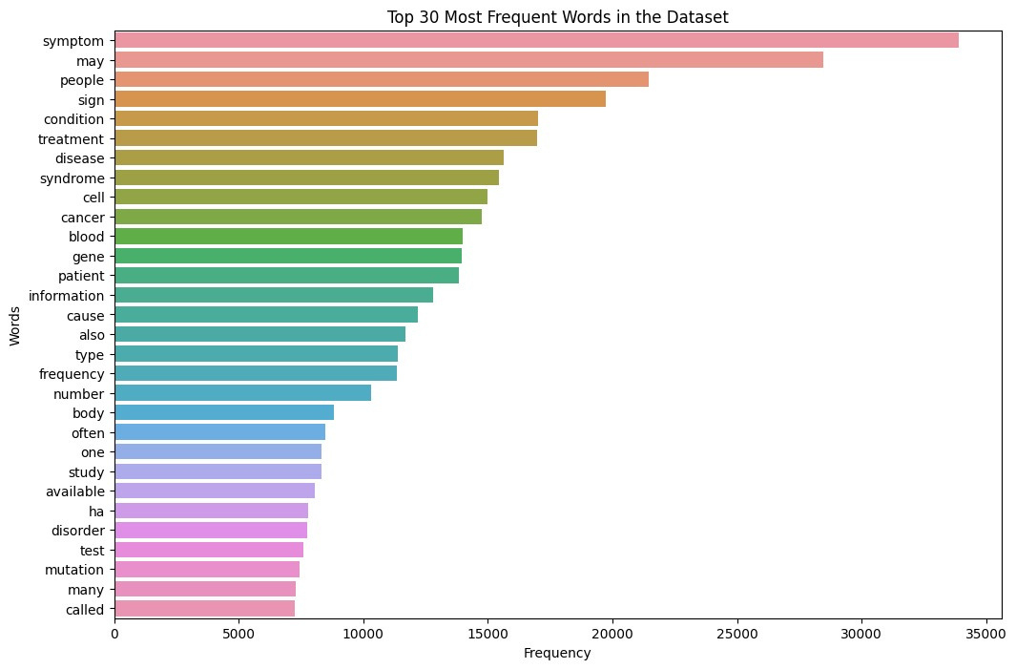
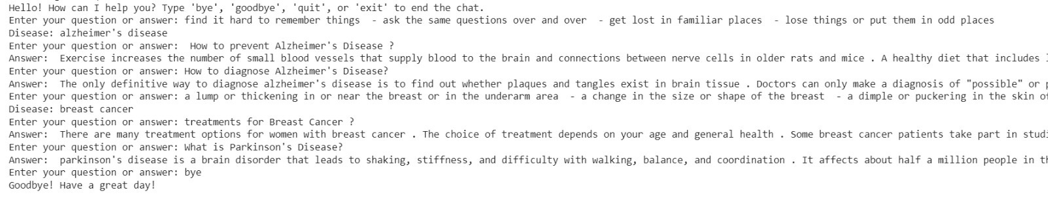
outputs
The graph shows the most frequent words in the whole dataset which shows their importance
chatpot answer

Slide 8
CONCLUSION
&NEXT STEPS
The healthcare chatbot project represents a technological leap in patient engagement and medical information accessibility. using advanced NLP techniques, including Word2Vec embeddings and BERT-based question-answering, the chatbot offers personalized 24/7 assistance. Dataset analysis, featuring N-grams and cosine similarity, provides valuable insights into user interactions. The patient-centric approach, reducing language gaps and predicting diseases, underscores a commitment to informed healthcare decisions. Future directions include continuous refinement, expanded services, and collaboration with healthcare professionals for ongoing innovation.
for future steps: We can build a faster model with a larger variance and complexity, implementing the nearest hospital contacts to the patient's location or connection the chatbot to GPS for emergency cases

Slide 9
THANK YOU!
Group members
Arwa Ahmed Mostafa 221100209
Menna Salem Elsayed 221101277
Rawan Khaled Khalil 221100808
Course Code: AIE241
Course Name: Natural Language Processing
Academic Year 2023/2024
semester: Fall

